Slide 1








LiveWire (Pro)
CoolStar
@coolstarorg
http://coolstar.org/
RecordMyScreen
SemiRestore, SemiRestore7
ClassicDock
ClassicLockScreen
iOS and Windows Engineer. Member of HASHBANG Productions (@hbangws).
BetterPowerDown
Procyon (@procyonapp)s
Choice
It’s all about what each person wants for themselves. A jailbroken device should be customizable to how the user wants it to be. Developers should also be able to develop for iOS, from the platform of their choice, anytime, anywhere.

Slide 2
Background
Wanted to get into iOS development in late 2011
Not much documentation was online in 2011 about developing without a Mac
Macs, unfortunately cost about 3x an average PC
Finally discovered “installsdk3” and “installtheos3” but these were iOS 3.0’s SDK… and that’s really badly out of date.

Slide 3
iOS development without OS X today
Latest Open Source iOS toolchain available has been ported to Windows, iOS, and Linux
This toolchain Supports:
The latest iOS 7.1 SDK
Building iOS 7 compatible tweaks
ARMv6 and ARMv7 Architectures (iPhone 2G -> A6X)
Note: Full ARM64 support should be coming later this year
Notes:
The latest iOS toolchain has been ported to Windows, iOS, and Linux.

Slide 4
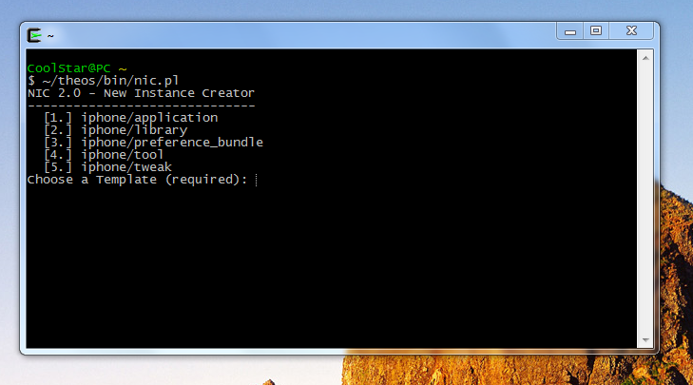
Theos running on…. Well Windows, of course!
Notes:
Didn’t expect this, right? Theos running on Windows.

Slide 5
Recommended Programs for development
(All of these are cross-platform)
Sublime Text (http://sublimetext.com/) - An excellent text editor with Objective-C support
class-dump-z (https://code.google.com/p/networkpx/wiki/class_dump_z) - Use this to find all the private Objective-C APIs
IDA (demo works fine) (https://www.hex-rays.com/products/ida/)
- Use this to look in methods or find private C and C++ methods

Slide 6
Good online resources for development
http://sharedinstance.net/2013/12/build-on-windows/ - Detailed Setup Instructions for Windows
IRC Server: irc.saurik.com Channel: Theos A client like Quassel (http://quassel-irc.org/) can be used to access the IRC.
http://iphonedevwiki.net/ - Contains well-written pages on aspects of tweak development

